Slide 1
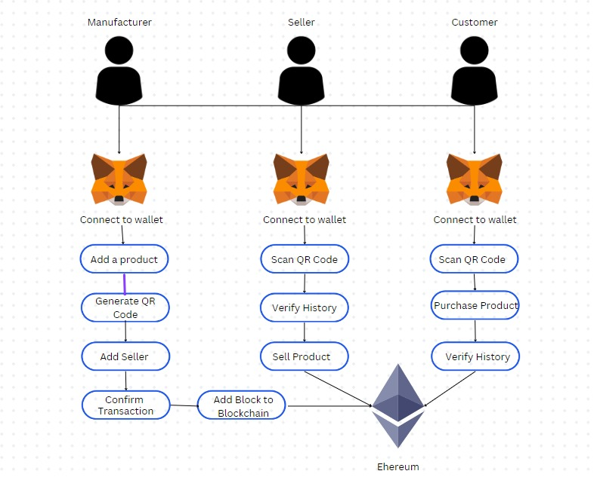
ARCHITECTURE
MAJOR PROJECT PHASE – 2 FINAL REVIEW

Slide 2
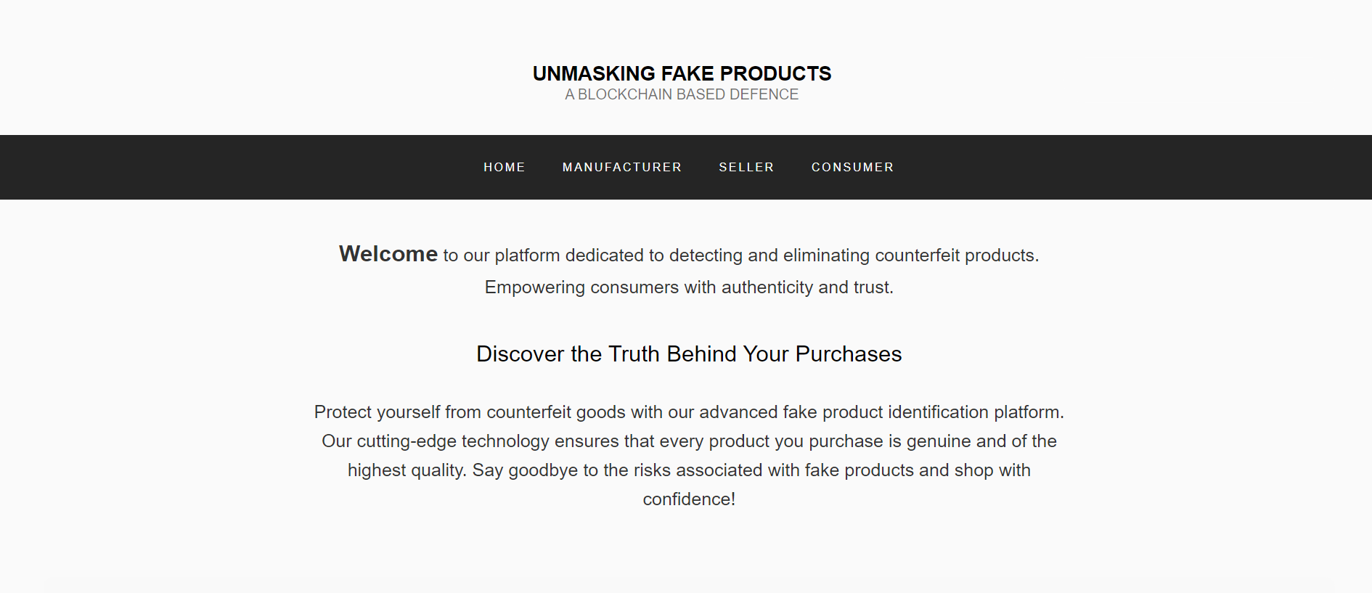
GUI
Home page of the User Interface
MAJOR PROJECT PHASE – 2 FINAL REVIEW

Slide 3
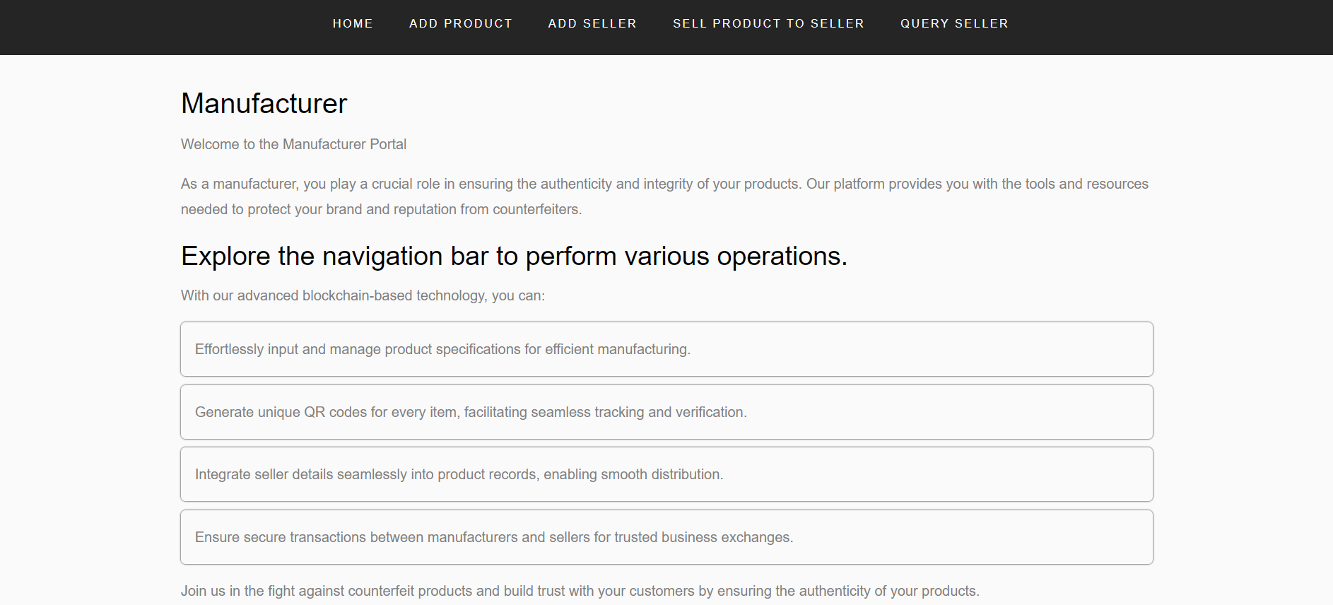
GUI
Manufacturer Page of the User Interface
MAJOR PROJECT PHASE – 2 FINAL REVIEW

Slide 4
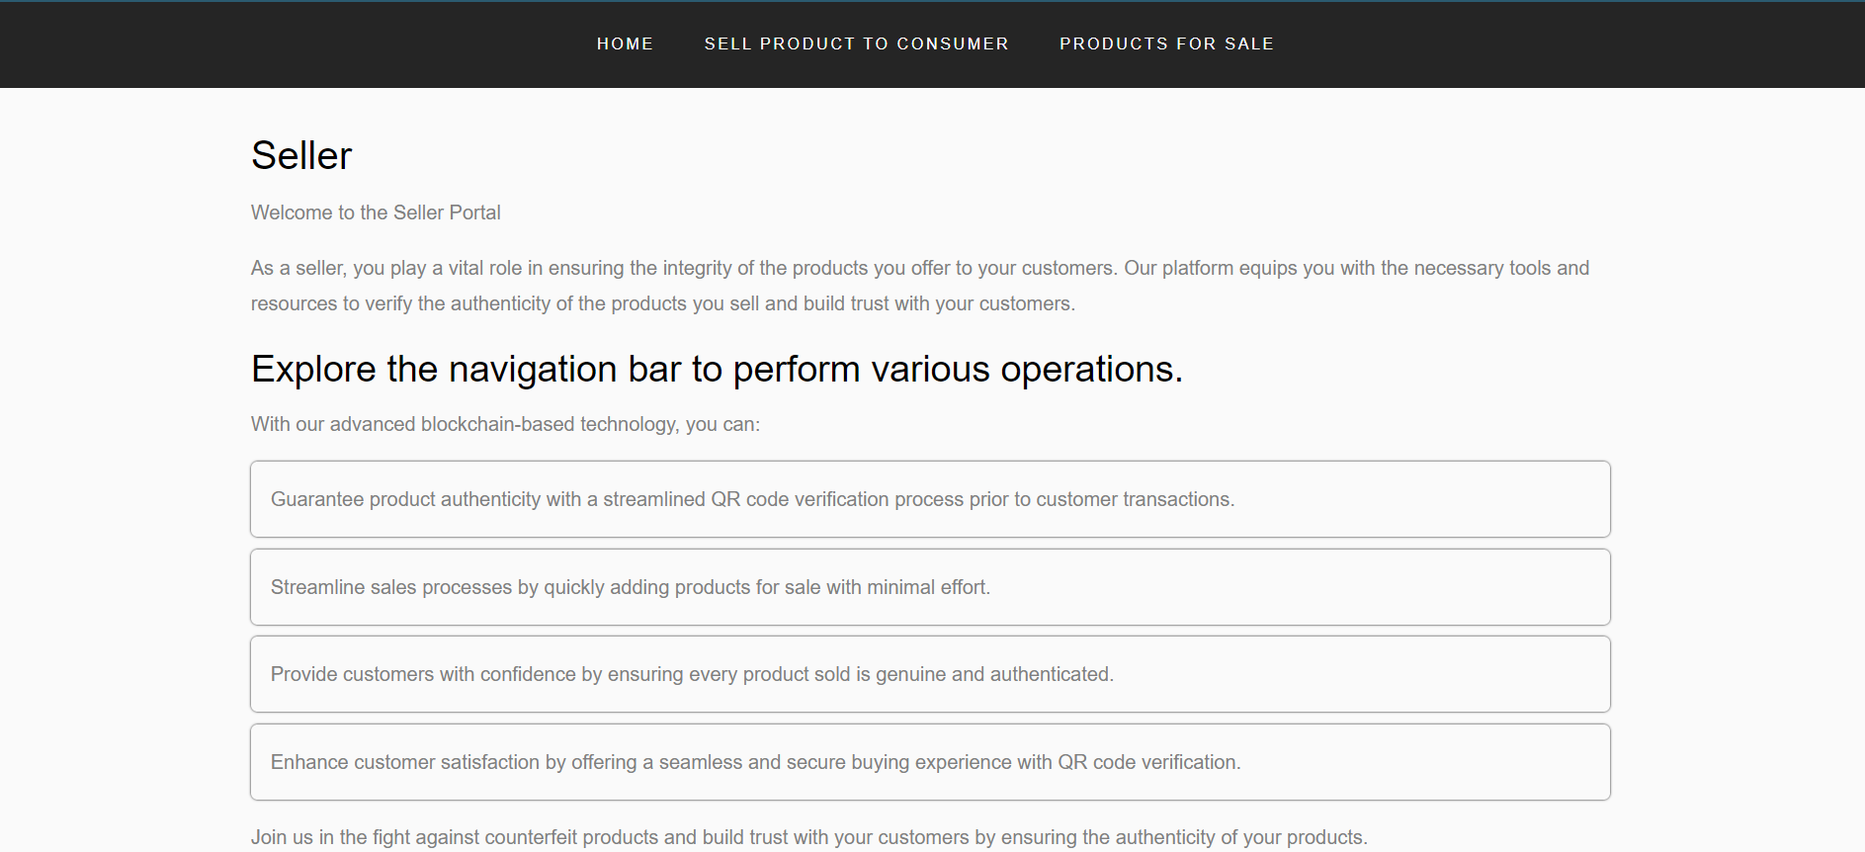
GUI
Seller page of the User Interface
MAJOR PROJECT PHASE – 2 FINAL REVIEW

Slide 5
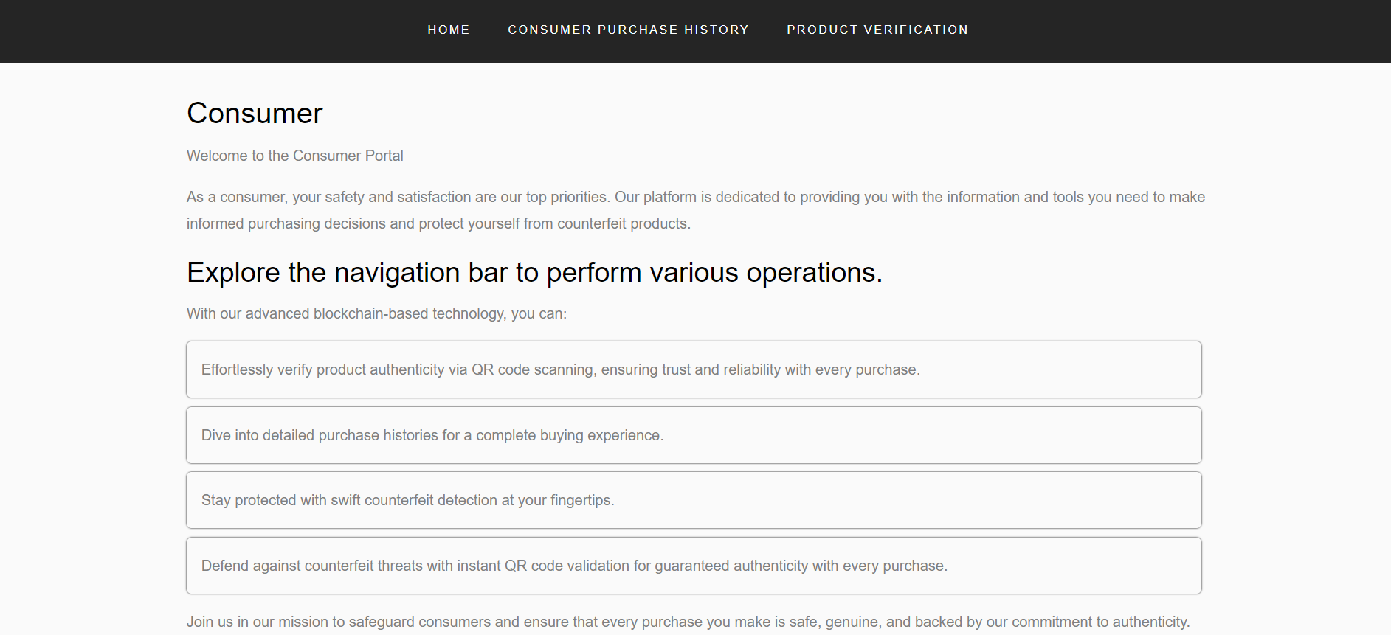
GUI
Consumer page of the User Interface
MAJOR PROJECT PHASE – 2 FINAL REVIEW

Slide 6
RESULT ANALYSIS
Test CaseID | Test Scenario | Expected Results | Actual Results | Status Pass/ Fail
1 | Manufacturer's Actions: Upload details and QR Code Generation | The QR code is successfully generated, and the system takes the input of the manufacturer. | The QR code is successfully generated, and the system takes the input of the manufacturer. | PASS
2 | Manufacturer's Actions: Adding Product Details | Product details are accurately added. | Product details are accurately added. | PASS
3 | Supplier's Actions: Upload details and QR Code Scanning | The QR code is successfully scanned, and the product information is accessible. | The QR code is successfully scanned, and the product information is accessible. | PASS
4 | Adding Supplier Details: Supplier adds their details, such as phone number, destination. | The supplier's details are correctly added. | The supplier's details are correctly added. | PASS
MAJOR PROJECT PHASE – 2 FINAL REVIEW

Slide 7
RESULT ANALYSIS
5 | Manufacturer’s Action: Sell product to the Seller | The QR code is scanned, and the corresponding Product Serial Number (SN) is retrieved, then sold to the supplier. | The QR code is scanned, and the corresponding Product Serial Number (SN) is retrieved, then sold to the supplier. | PASS
6 | Manufacturer’s Action: Retrieving the sellers details | The manufacturer can access seller details through the blockchain network using the manufacturer code. | The manufacturer can access seller details through the blockchain network using the manufacturer code. | PASS
7 | Supplier’s Action: QR Code Scanning and Selling Products | The QR code is scanned, and the corresponding Product Serial Number (SN) is retrieved, then supplier can sell the product to the consumer by having the consumer code. | The QR code is scanned, and the corresponding Product Serial Number (SN) is retrieved, then supplier can sell the product to the consumer by having the consumer code. | PASS
MAJOR PROJECT PHASE – 2 FINAL REVIEW

Slide 8
RESULT ANALYSIS
8 | Supplier’s Action: Retrieving information of the products | By entering the Seller Code, the product details are displayed. | By entering the Seller Code, the product details are displayed. | PASS
9 | Consumer’s Action: Retrieving the product details | By entering the consumer code, consumer can know what products are purchased and the details of the product. | By entering the consumer code, consumer can know what products are purchased and the details of the product. | PASS
10 | Consumer’s Action: QR Code Scanning and Verification of the products. | The QR code is scanned, and the corresponding Product Serial Number (SN) is retrieved. Then by adding the consumer code, consumer can know the product is genuine or fake. | The QR code is scanned, and the corresponding Product Serial Number (SN) is retrieved. Then by adding the consumer code, consumer can know the product is genuine or fake. | PASS
MAJOR PROJECT PHASE – 2 FINAL REVIEW

Slide 9
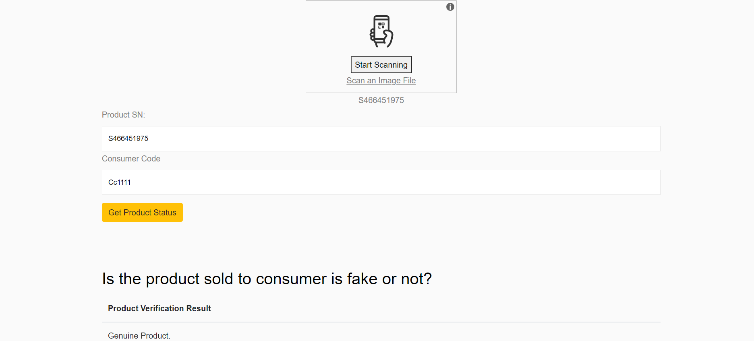
RESULT ANALYSIS
The result will show as genuine product if the Product Serial Number (SN) matches the Consumer Code, indicating that the product was sold to that particular consumer.
MAJOR PROJECT PHASE – 2 FINAL REVIEW

Slide 10

RESULT ANALYSIS
The result will show as fake product if the Product Serial Number (SN) does not match the Consumer Code, indicating that the product was not sold to that particular consumer.
MAJOR PROJECT PHASE – 2 FINAL REVIEW

Slide 11
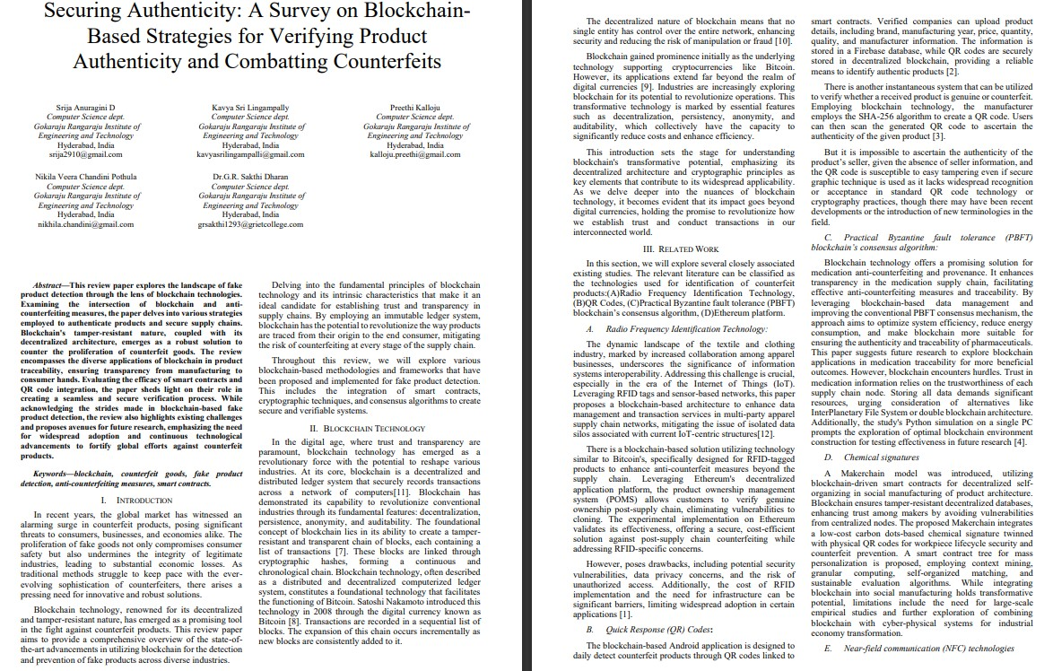
Securing Authenticity: A Survey on Blockchain-Based Strategies for Verifying Product Authenticity and Combatting Counterfeits
Srija Anuragini D Computer Science dept. Gokaraju Rangaraju Institute of Engineering and Technology Hyderabad, Indiasrija2910@gmail.com
Nikila Veera Chandini PothulaComputer Science dept. Gokaraju Rangaraju Institute of Engineering and Technology Hyderabad, Indianikhila.chandini@gmail.com
Kavya Sri Lingampally Computer Science dept. Gokaraju Rangaraju Institute of Engineering and Technology Hyderabad, Indiakavyasrilingampalli@gmail.com
Dr.G.R. Sakthi DharanComputer Science dept. Gokaraju Rangaraju Institute of Engineering and Technology Hyderabad, Indiagrsakthi1293@grietcollege.com
Preethi KallojuComputer Science dept. Gokaraju Rangaraju Institute of Engineering and Technology Hyderabad, Indiakalloju.preethi@gmail.com
Abstract—This review paper explores the landscape of fake product detection through the lens of blockchain technologies. Examining the intersection of blockchain and anti-counterfeiting measures, the paper delves into various strategies employed to authenticate products and secure supply chains. Blockchain's tamper-resistant nature, coupled with its decentralized architecture, emerges as a robust solution to counter the proliferation of counterfeit goods. The review encompasses the diverse applications of blockchain in product traceability, ensuring transparency from manufacturing to consumer hands. Evaluating the efficacy of smart contracts and QR code integration, the paper sheds light on their role in creating a seamless and secure verification process. While acknowledging the strides made in blockchain-based fake product detection, the review also highlights existing challenges and proposes avenues for future research, emphasizing the need for widespread adoption and continuous technological advancements to fortify global efforts against counterfeit products.
Keywords—blockchain, counterfeit goods, fake product detection, anti-counterfeiting measures, smart contracts.
I. Introduction
In recent years, the global market has witnessed an alarming surge in counterfeit products, posing significant threats to consumers, businesses, and economies alike. The proliferation of fake goods not only compromises consumer safety but also undermines the integrity of legitimate industries, leading to substantial economic losses. As traditional methods struggle to keep pace with the ever-evolving sophistication of counterfeiters, there arises a pressing need for innovative and robust solutions.
Blockchain technology, renowned for its decentralized and tamper-resistant nature, has emerged as a promising tool in the fight against counterfeit products. This review paper aims to provide a comprehensive overview of the state-of-the-art advancements in utilizing blockchain for the detection and prevention of fake products across diverse industries.
Delving into the fundamental principles of blockchain technology and its intrinsic characteristics that make it an ideal candidate for establishing trust and transparency in supply chains. By employing an immutable ledger system, blockchain has the potential to revolutionize the way products are traced from their origin to the end consumer, mitigating the risk of counterfeiting at every stage of the supply chain.
Throughout this review, we will explore various blockchain-based methodologies and frameworks that have been proposed and implemented for fake product detection. This includes the integration of smart contracts, cryptographic techniques, and consensus algorithms to create secure and verifiable systems.
II. Blockchain Technology
In the digital age, where trust and transparency are paramount, blockchain technology has emerged as a revolutionary force with the potential to reshape various industries. At its core, blockchain is a decentralized and distributed ledger system that securely records transactions across a network of computers[11]. Blockchain has demonstrated its capability to revolutionize conventional industries through its fundamental features: decentralization, persistence, anonymity, and auditability. The foundational concept of blockchain lies in its ability to create a tamper-resistant and transparent chain of blocks, each containing a list of transactions [7]. These blocks are linked through cryptographic hashes, forming a continuous and chronological chain. Blockchain technology, often described as a distributed and decentralized computerized ledger system, constitutes a foundational technology that facilitates the functioning of Bitcoin. Satoshi Nakamoto introduced this technology in 2008 through the digital currency known as Bitcoin [8]. Transactions are recorded in a sequential list of blocks. The expansion of this chain occurs incrementally as new blocks are consistently added to it.
REVIEW PAPER
MAJOR PROJECT PHASE – 2 FINAL REVIEW

Slide 12
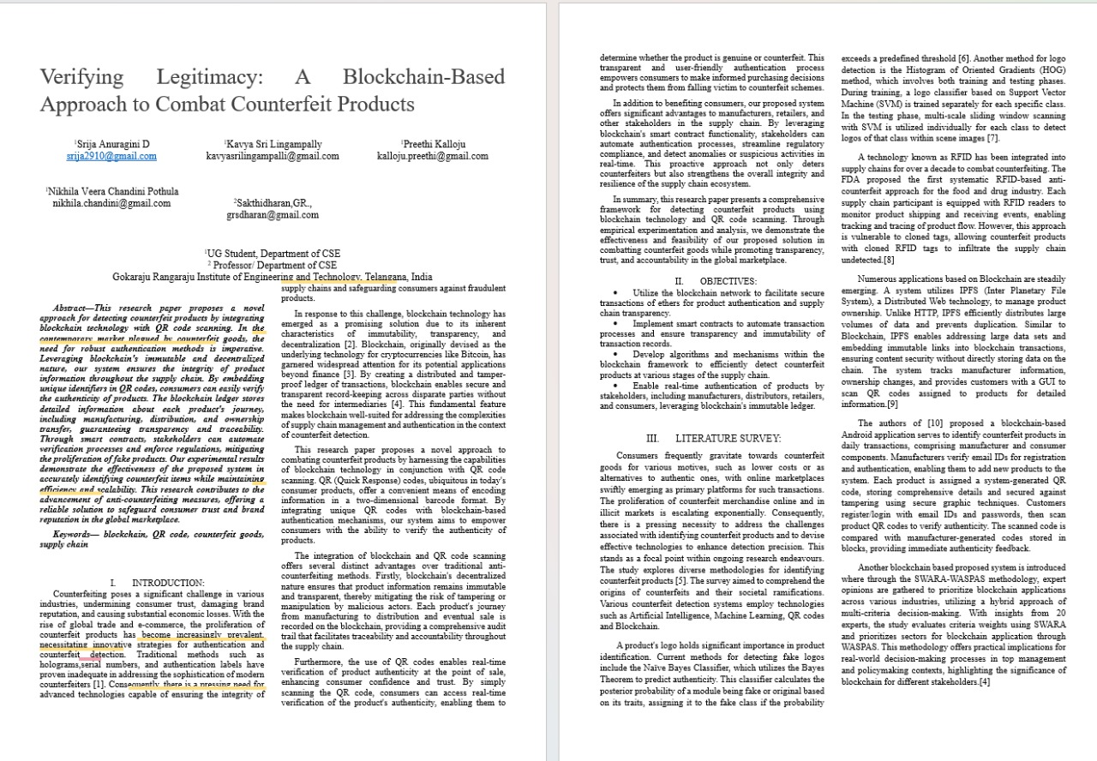
Securing Authenticity: A Survey on Blockchain-Based Strategies for Verifying Product Authenticity and Combatting Counterfeits
Srija Anuragini D Computer Science dept. Gokaraju Rangaraju Institute of Engineering and Technology Hyderabad, Indiasrija2910@gmail.com
Nikila Veera Chandini PothulaComputer Science dept. Gokaraju Rangaraju Institute of Engineering and Technology Hyderabad, Indianikhila.chandini@gmail.com
Kavya Sri Lingampally Computer Science dept. Gokaraju Rangaraju Institute of Engineering and Technology Hyderabad, Indiakavyasrilingampalli@gmail.com
Dr.G.R. Sakthi DharanComputer Science dept. Gokaraju Rangaraju Institute of Engineering and Technology Hyderabad, Indiagrsakthi1293@grietcollege.com
Preethi KallojuComputer Science dept. Gokaraju Rangaraju Institute of Engineering and Technology Hyderabad, Indiakalloju.preethi@gmail.com
Abstract—This review paper explores the landscape of fake product detection through the lens of blockchain technologies. Examining the intersection of blockchain and anti-counterfeiting measures, the paper delves into various strategies employed to authenticate products and secure supply chains. Blockchain's tamper-resistant nature, coupled with its decentralized architecture, emerges as a robust solution to counter the proliferation of counterfeit goods. The review encompasses the diverse applications of blockchain in product traceability, ensuring transparency from manufacturing to consumer hands. Evaluating the efficacy of smart contracts and QR code integration, the paper sheds light on their role in creating a seamless and secure verification process. While acknowledging the strides made in blockchain-based fake product detection, the review also highlights existing challenges and proposes avenues for future research, emphasizing the need for widespread adoption and continuous technological advancements to fortify global efforts against counterfeit products.
Keywords—blockchain, counterfeit goods, fake product detection, anti-counterfeiting measures, smart contracts.
I. Introduction
In recent years, the global market has witnessed an alarming surge in counterfeit products, posing significant threats to consumers, businesses, and economies alike. The proliferation of fake goods not only compromises consumer safety but also undermines the integrity of legitimate industries, leading to substantial economic losses. As traditional methods struggle to keep pace with the ever-evolving sophistication of counterfeiters, there arises a pressing need for innovative and robust solutions.
Blockchain technology, renowned for its decentralized and tamper-resistant nature, has emerged as a promising tool in the fight against counterfeit products. This review paper aims to provide a comprehensive overview of the state-of-the-art advancements in utilizing blockchain for the detection and prevention of fake products across diverse industries.
Delving into the fundamental principles of blockchain technology and its intrinsic characteristics that make it an ideal candidate for establishing trust and transparency in supply chains. By employing an immutable ledger system, blockchain has the potential to revolutionize the way products are traced from their origin to the end consumer, mitigating the risk of counterfeiting at every stage of the supply chain.
Throughout this review, we will explore various blockchain-based methodologies and frameworks that have been proposed and implemented for fake product detection. This includes the integration of smart contracts, cryptographic techniques, and consensus algorithms to create secure and verifiable systems.
II. Blockchain Technology
In the digital age, where trust and transparency are paramount, blockchain technology has emerged as a revolutionary force with the potential to reshape various industries. At its core, blockchain is a decentralized and distributed ledger system that securely records transactions across a network of computers[11]. Blockchain has demonstrated its capability to revolutionize conventional industries through its fundamental features: decentralization, persistence, anonymity, and auditability. The foundational concept of blockchain lies in its ability to create a tamper-resistant and transparent chain of blocks, each containing a list of transactions [7]. These blocks are linked through cryptographic hashes, forming a continuous and chronological chain. Blockchain technology, often described as a distributed and decentralized computerized ledger system, constitutes a foundational technology that facilitates the functioning of Bitcoin. Satoshi Nakamoto introduced this technology in 2008 through the digital currency known as Bitcoin [8]. Transactions are recorded in a sequential list of blocks. The expansion of this chain occurs incrementally as new blocks are consistently added to it.
RESEARCH PAPER
MAJOR PROJECT PHASE – 2 FINAL REVIEW

Slide 13
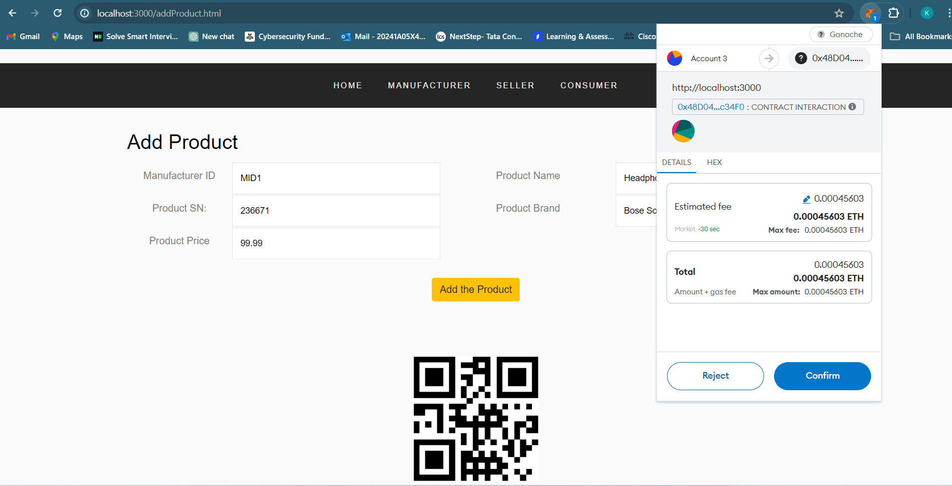
SNAPSHOTS
Product details entered by manufacturer
MAJOR PROJECT PHASE – 2 FINAL REVIEW

Slide 14
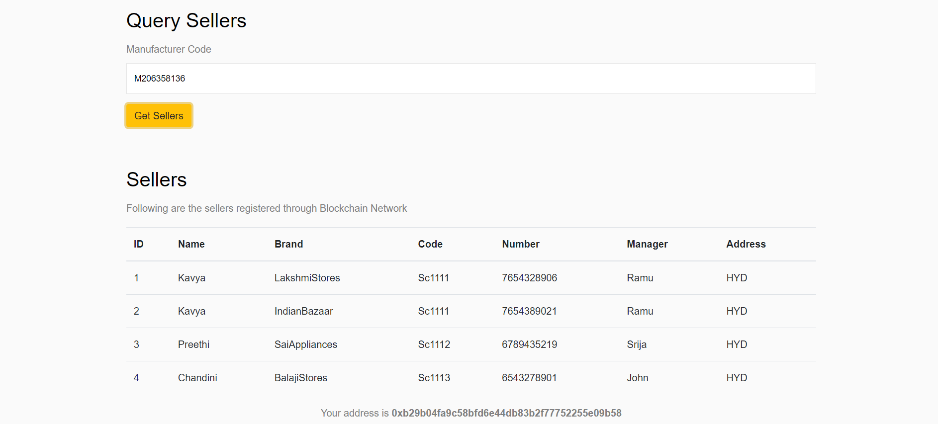
SNAPSHOTS
Entering the manufacturer code allows us to identify the sellers associated with the manufacturer.
MAJOR PROJECT PHASE – 2 FINAL REVIEW

Slide 15
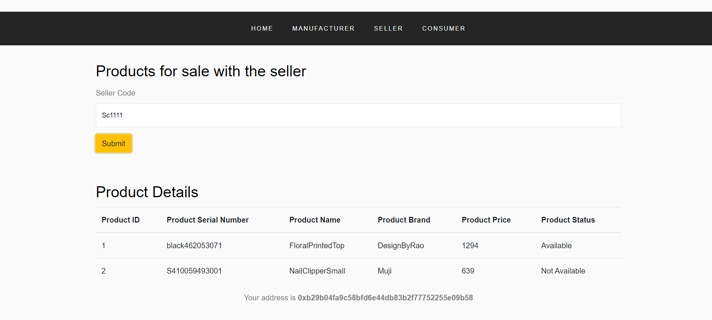
SNAPSHOTS
Entering the seller code allows us to identify the product details associated with the seller.
MAJOR PROJECT PHASE – 2 FINAL REVIEW

Slide 16
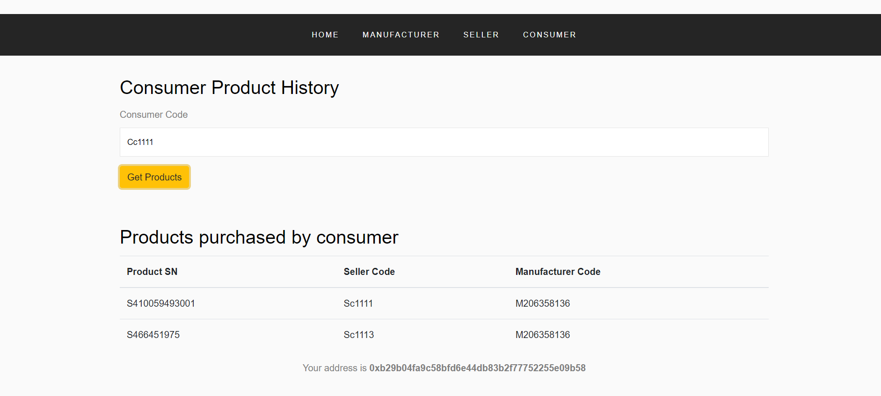
SNAPSHOTS
Entering the consumer code allows us to identify the products purchased by the consumer.
MAJOR PROJECT PHASE – 2 FINAL REVIEW

